Slide 1

ECE 537 / CIS 568 - Data Mining
ARCTIc Amazon Review Classification using TF-IDF VeCtors
Samuel Bellaire¹ Theodore Sullivan²
1. TF-IDF Feature Space, Logistic Regression Model, ANN Model
2. Dictionary Construction using Ⲭ ², Decision Tree Model, k-NN Model

Slide 2
Note:
This set of slides describes only Theodore Sullivan’s contributions to the project. This is not the full set of presentation slides. Please refer to the Final Presentation for the full set of slides.

Slide 3
Objective:
Given the text of an Amazon review, determine whether it is a good, bad, or neutral review.

Slide 4

Dataset
Amazon Review Dataset
J. Ni, J. Li, and J. McAuley. Justifying Recommendations using Distantly-Labeled Reviews and Fine-Grained Aspects. EMNLP-IJCNLP 2019.
Electronics 5-core dataset → 6,739,590 reviews
All products and reviewers have 5 or more reviews
We extracted 3 stratified subsets for our work (70/15/15 split)
150K training instances
30K validation instances
30K testing instances
Amazon Review Dataset

Slide 5
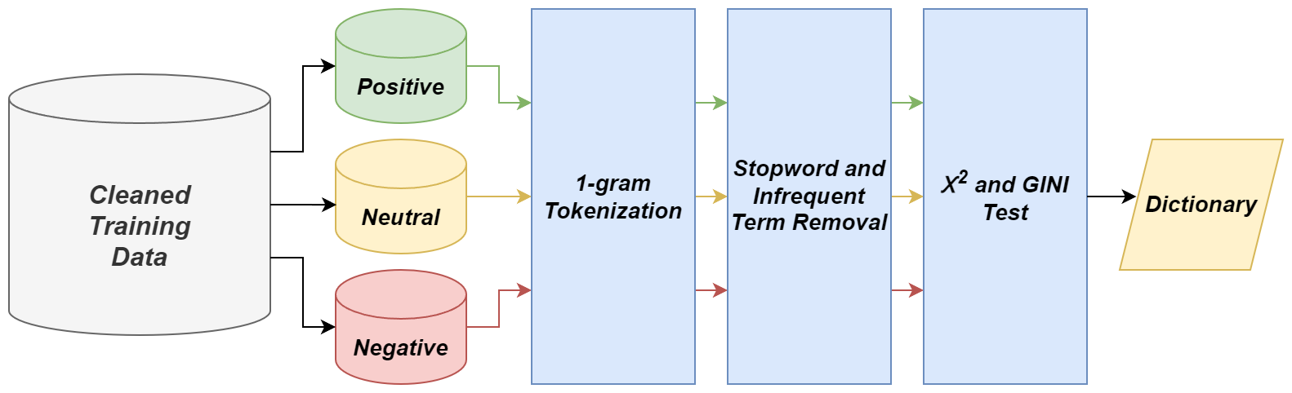
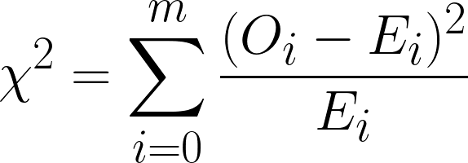
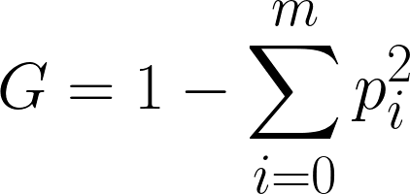
Dictionary Construction Workflow

Slide 6
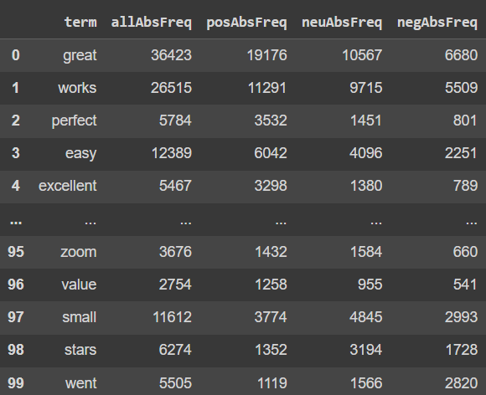
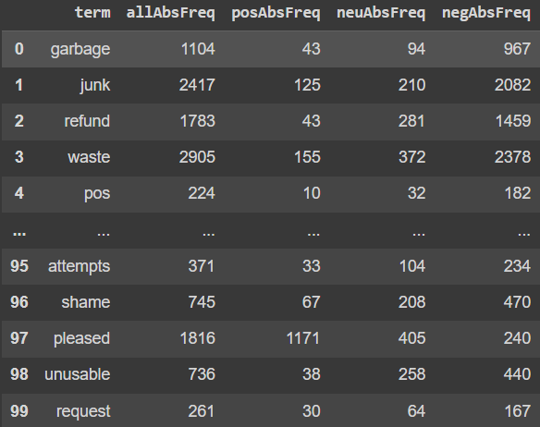
Dictionary Construction Workflow
Sorted by Ⲭ ²
Sorted by GINI Impurity
Ⲭ ² produced better results than GINI in testing

Slide 7
Machine Learning Approaches
2
Decision Tree
scikit-learn
3
k-Nearest Neighbours
scikit-learn

Slide 8
Decision Tree Model
Parameters
Optimization Criterion: Entropy
Max. Tree Depth: 14
Min. Samples to Split: 1000
Min. Samples per Leaf: 50
Class Weight: Balanced
Grid search was utilized to determine parameters
3-Class, Accuracy = 40.27%
 | Pred + | Pred - | Pred ~
True + | 2699 | 6923 | 378
True - | 756 | 8884 | 360
True ~ | 1197 | 8317 | 486
2-Class, Accuracy = 59.82%
 | Pred + | Pred -
True + | 3069 | 6931
True - | 1106 | 8894

Slide 9
k-NN Clustering Algorithm
Parameters
Distance Metric: Euclidean
Neighbours (k): 125
Grid search was utilized to determine parameters
k-NN impractical due to the high number of distance computations (>100K data points)
3-Class, Accuracy = 40.04%
 | Pred + | Pred - | Pred ~
True + | 2553 | 6981 | 466
True - | 623 | 8931 | 446
True ~ | 1026 | 8378 | 596
2-Class, Accuracy = 59.65%
 | Pred + | Pred -
True + | 2874 | 7126
True - | 943 | 9057

